Slide 1

ANZ Transactions

Slide 2
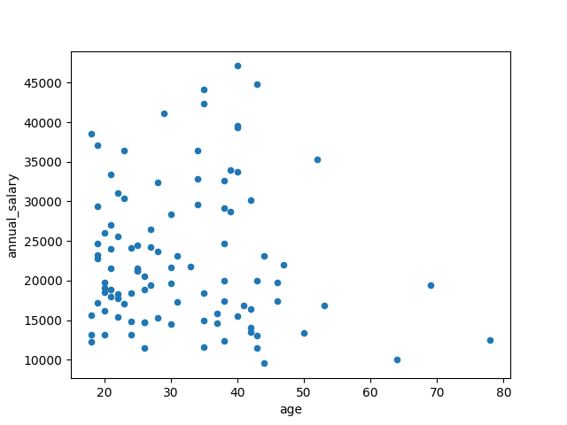
Annual salary vs. age
Weak positive correlation between age and annual salary
There are individuals aged in their 20-30s who have a low salary but also individuals in 40-50s who have a high salary

Slide 3
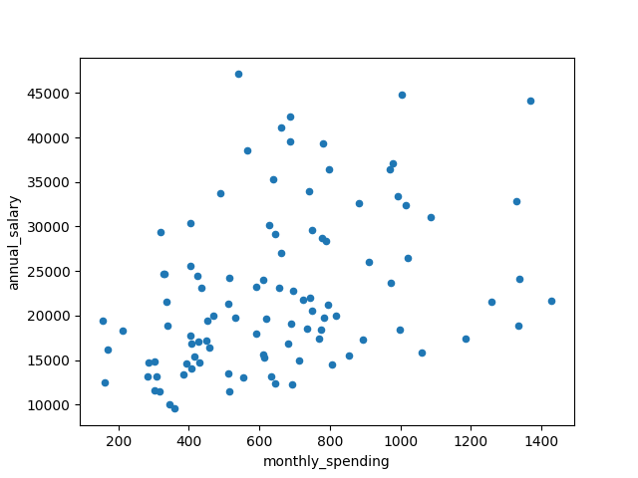
Annual salary vs. monthly spending
Moderate positive correlation between monthly spending and annual salary
Possibly a higher annual salary enables higher spending

Slide 4
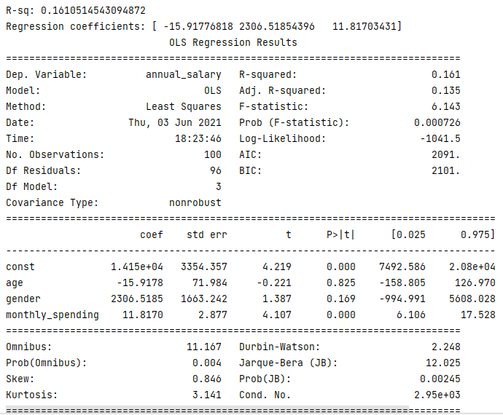
Multiple linear regression of annual spending
Regressed on age, gender and monthly spending
Model is not a good fit → R-sq: 0.16
Predicts that salary declines with age → not always the case in reality
Males earn $2386 more than females
Individuals with higher spending are also those with higher salaries

